Slide 1


Slide 2
AI-Powered Size Chart Generator for Apparel Sellers
Title | FitSenseXAI + Software Development
Team Name | arjunmohanty003
Team Member | Arjun Mohanty
Role | Leader
College/University | Odisha University of Technology and Research, Bhubaneswar, Odisha
Date | 25.08.2024

Slide 3
Executive Summary:
Overview: Apparel Sellers often struggle with limited or inaccurate size data, leading to high return rates, which affects the operational efficiency and inventory management issues,while also causing customer dissatisfaction.
Solution:
Data Collection: Collecting user body measurements such as height, weight, chest, waist, hip and store this data securely in a database, ideally in an anonymized format to ensure user privacy.
Historical Data Analysis: Analyzing the previous purchase history of user and return related information by implementing the machine learning algorithms and employ data mining techniques to identify the patterns related to size discrepancies.
Clustering of Body types: Implement Clustering algorithms such as SVM or DBSCAN to group users with similar body types based on their measurements and purchase history.
Generating Size Charts: Generating size-charts for sellers by analyzing user body measurements using Decision Trees and Neural Networks to predict and recommend accurate measurements for the users.
Confidence Score Implementation: Introducing the concept of confidence scores for each measurement to indicate the reliability of the data based on the volume and consistency of historical data, and incorporate these scores into an incentive program for sellers like Seller Excellence Incentive, rewarding them for achieving lower return rates and maintaining high data accuracy.
Dynamic Updates: Ensuring seamless updates so that system can easily integrate new purchase data by using algorithms like Stochastic Gradient Descent (SGD) which can continuously update the model with new data becomes available.
Key Findings/Recommendations:
Accuracy: AI can significantly enhance the accuracy of size charts approximately up to 94%, leading to better customer satisfaction.
Clustering Body Measurements: AI helps in clustering various body measurements to generate more precise size recommendations.
Reducing Return Rates: AI-driven size recommendation systems can reduce the return rates up to 30-40% in fashion retail industry.
Impact:
Inventory Management: AI driven size recommendation system helps in aligning inventory with actual demand, reducing overstock and stockouts.
Accurate sizing: AI driven recommendation system enhances the customer experience by reducing size-related issues, leading to higher satisfaction and loyalty.
Reduction of waste: Lower return rates and improved inventory management help reduce waste associated with unsold or returned clothing, contributing to environmental sustainability.
Data-driven Insights: Sellers gain valuable insights to understand customer preferences and sizing trends,offering more personalized product recommendations for the customers.

Slide 4
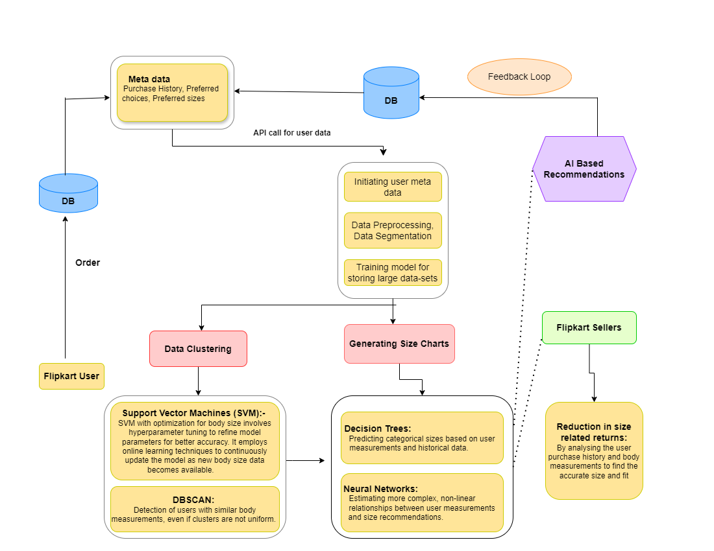
Architecture:

Slide 5
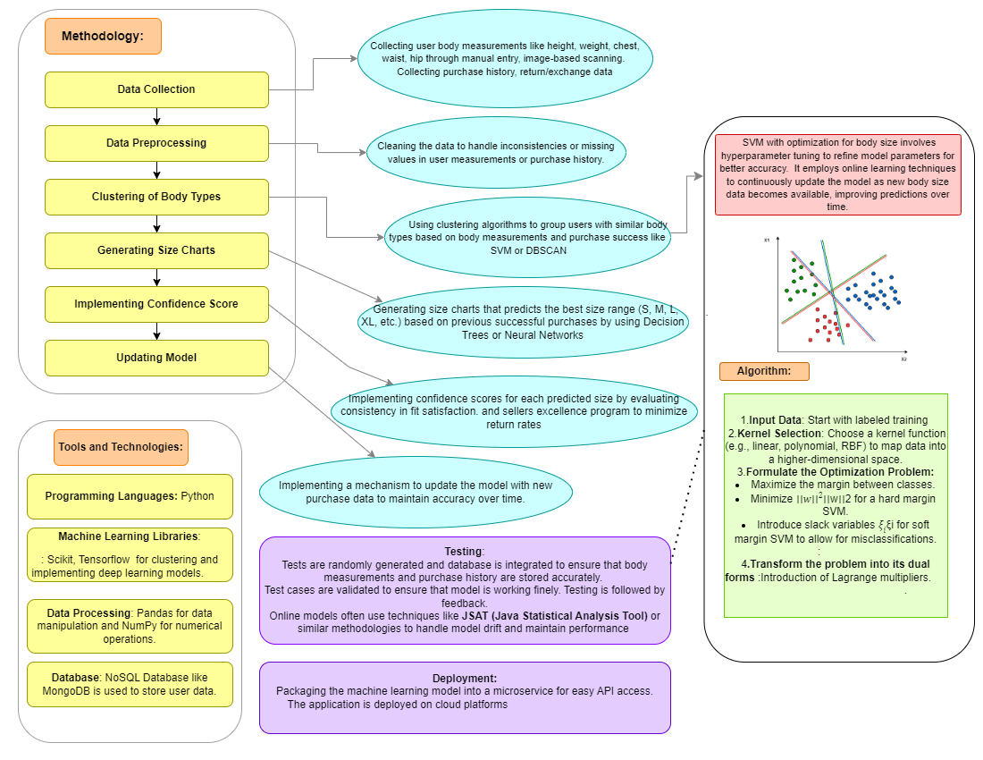
Technical Approach:

Slide 6
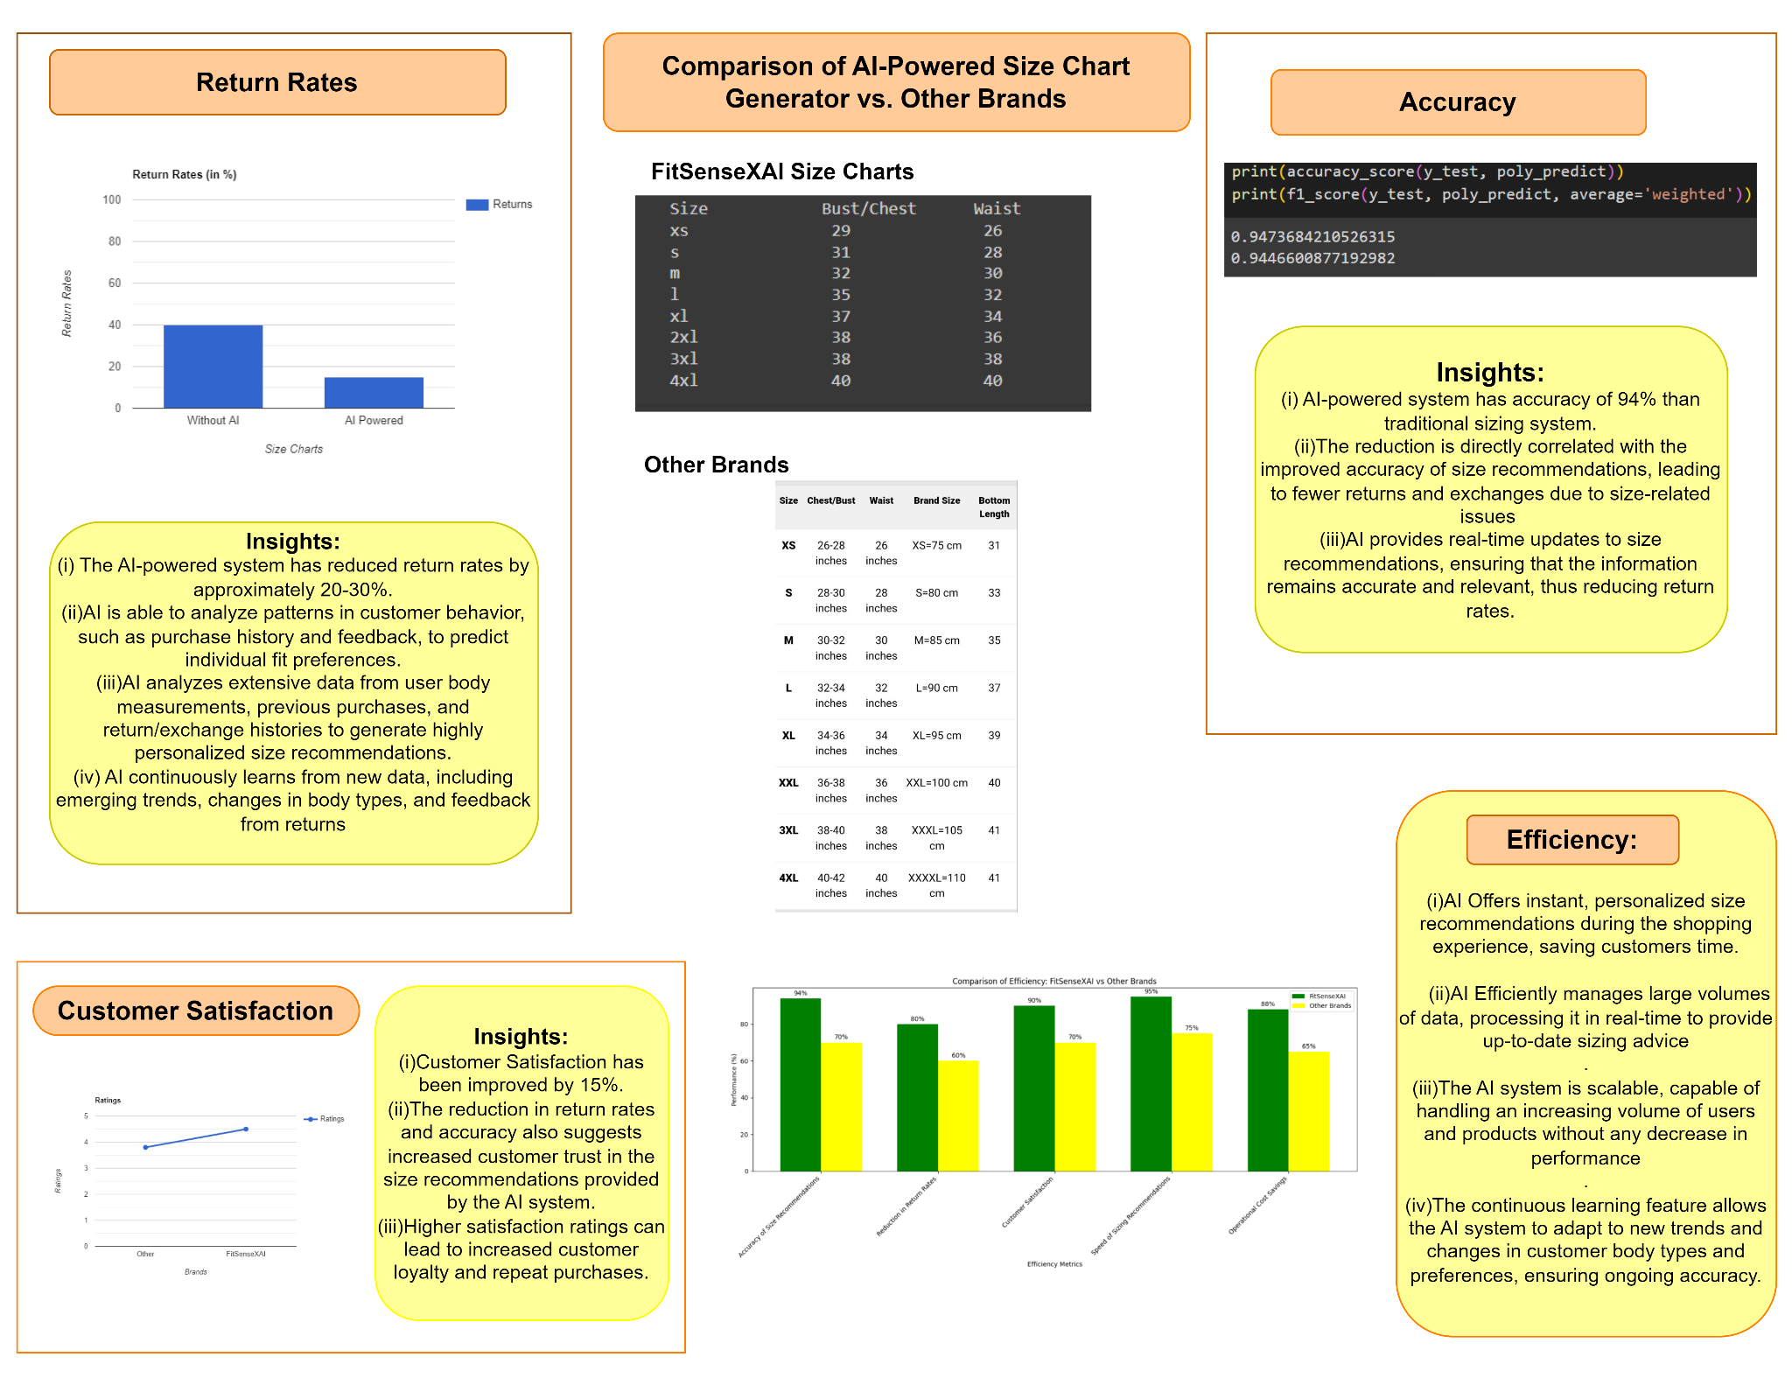
Results and Analysis:

Slide 7
Challenges and Limitations:
Challenges: The AI driven solution model presents a unique set of challenges that require innovative solutions to ensure accuracy, scalability and user trust. The Challenges that are encountered while developing the solution model are as follows:
Data Privacy: Collecting and storing sensitive user data like body measurements and purchase history involves strict adherence to privacy laws and regulation. Ensuring Compliance while collecting data to make accurate prediction is a big challenge.
Approach: Data Anonymization techniques are implemented to remove or mask personal identifiable information from the dataset. The user data is stored in secure cloud storage platforms to ensure data protection.
Handling diverse body types: The AI model needs to account for a wide variety of body types and preferences, making it challenging to create a one-size-fits-all model. Clustering similar body types while maintaining accuracy across diverse groups is a complex task.
Approach:Developed Personalized models that cater to individual preferences and measurements within each cluster The AI model uses Neural Network to create adaptive size recommendation for users. The AI model also uses clustering algorithms like SVM, DBSCAN to effectively group similar body types.
Platform Compatibility: Integrating the AI-powered size chart generator with existing platforms can be challenging due to differences in data formats, API structures, and system architectures.
Approach: Seamless integration by integrating standardized data formats, adaptable APIs and flexible architecture designs to accommodate the various requirements of the platform.
Real-time Performance: The AI model needs to provide real-time recommendations without significant delays,ensuring that system can handle large numbers of concurrent users while maintaining fast response times.
Approach: Distributed computing and caching strategies are implemented to reduce latency, and uses auto-scaling to dynamically allocate resources based on user demand.
Limitations or Constraints :
New User: The AI driven system heavily relies on users' previous purchase history and return or exchange data. If a user is new to the platform or has limited purchase history, the model may struggle to provide accurate size recommendations.
Changing Body Size: The AI model must quickly adapt over time as certain customers body measurements like weight loss or gain change over time to ensure that the system must continuously learn from new data.
Seasonal fashion changes and varying clothing styles can significantly impact the model’s accuracy by introducing variability in size requirements which may be a constraint for the AI system to make accurate size recommendations.across various fashion trends.

Slide 8
Recommendations and Future Work :
Technology is rapidly improving, prompting recommendations and future works to enhance the AI driven system to offer more personalized, accurate, and inclusive size recommendations, reducing returns and improving customer satisfaction.The potential areas for further research or development in the AI driven system that generates accurate size charts for apparel sellers:
Advanced Body Measurement Methods:
Integrating 3D scanning via smartphone cameras for precise body measurements.Investigating the use of smart fabrics or wearable technology that can track body changes over time, providing real-time data on user measurements AI-driven image processing can be implemented to extract body measurements from user-submitted photos, using deep learning techniques to ensure accuracy.
Dynamic Adjustment for Body Changes :
Adaptive learning models can be implemented to continuously update user profiles as they input new body measurements or make new purchases.The adaptive size charts must automatically adjust based on detected changes in user body measurements over time.Implementing personalized notifications to alert users when significant body changes are detected, prompting updates to their size profile.
Inclusive Sizing for Diverse Body Types: Integrating algorithms that are inclusive of diverse body types and expanding the number of clusters in the size prediction model to better capture this variations. Adaptive algorithms can be implemented to learn from individual user feedback and adjust recommendations based on specific body types and fit preferences.
Real-time Feedback Integration: Allows real-time user feedback integration, such as after they receive and try on the product, providing an additional layer of validation to enhance future size recommendations.A feedback loop can also be implemented where users can rate the size of purchased items,which are then analyzed to refine size recommendations and improve overall sizing accuracy.
Advanced Predictive Analysis:
Analyzing historical data and emerging patterns, predictive analytics can help anticipate future size trends and customer preferences. This allows sellers to adapt their inventory and sizing options proactively. AI algorithms can analyze user data to personalize content and recommendations, making campaigns more relevant to individual preferences and behaviors.
Voice Based Real-time Seller Simulation: A voice based real-time seller interaction system can be implemented to integrate AI driven voice recognition to simulate dynamic seller interactions and develop adaptive algorithms for real-time feedback and training, and utilize natural language processing to refine communication strategies and enhance user engagement.

Slide 9
Appendices:
The objective of appendices is to provide comprehensive resources that elaborate on the various components of the AI driven system model for apparel sellers. By exploring these supplementary materials, one can gain a deeper understanding of the methodologies, data sources, and technological frameworks that supports the proposed solution:
User body measurements and Clustering: Exploring the importance of anthropometric data and clustering techniques that can be used to categorize different body types to generate accurate size charts. https://www.researchgate.net/publication/311648508_Identifying_Body_Size_Group_Clusters_from_Anthropometric_Body_Composition_Indicators.
Impact of AI on reducing return rates: Explores the impact of AI on the efficiency of online return policies.
https://link.springer.com/aricle/10.1007/s10479-020-03602-y
Classification of Body Types: Understanding various body shapes is an important aspect in generating size chart.The waist-hip ratio is used to determine the health issues in an individual.Detailed Insights on body types associated with health : https://pubmed.ncbi.nlm.nih.gov/16271645/
Size Recommendation system for E-commerce: A size recommendation system is implemented to automatically preselect consumer size based on previous purchase history. https://www.semanticscholar.org/paper/Size-Recommendation-System-for-Fashion-E-commerce-Abdulla-Designs/fa1d08c3fc643c0e41d3ed2e688bf9c9b389f066
Size Charts: Comparing size charts from different brands helps to train AI models for size recommendation by providing a diverse range of sizing data, which improves the model’s ability to generalize and accurately predict sizes across various brands and styles.
https://www.hm.com.cn/en_cn/customer-service/sizeguide/ladies
https://www.sizecharter.com/brands/zar/womens
https://www.flipkart.com/rv/sizechart?pid=TMLFAHYAACNRR3BZ
Clothing fit dataset for size recommendation: https://www.kaggle.com/datasets/rmisra/clothing-fit-dataset-for-size-recommendation/data

Slide 10


